Slide 1
Modern Cryptography
Public Key Infrastructure (PKI): PKI is a framework for managing digital keys and certificates. It is used for secure email, web browsing, and digital signatures. Certificate authorities issue digital certificates that bind public keys to identities.
In cryptography, a public key is a large numerical value that is used to encrypt data. The key can be generated by a software program, but more often, it is provided by a trusted, designated authority and made available to everyone through a publicly accessible directory

Slide 2

Public Key Infrastructure (PKI)
Is public key accessible to everyone?
While the private key must be stored securely, and not made known to anyone but its owner, the public key can be made freely available to any user, with no risk of compromising the security of the private key. Information encrypted using the public key can be decrypted only with the private key.

Slide 3
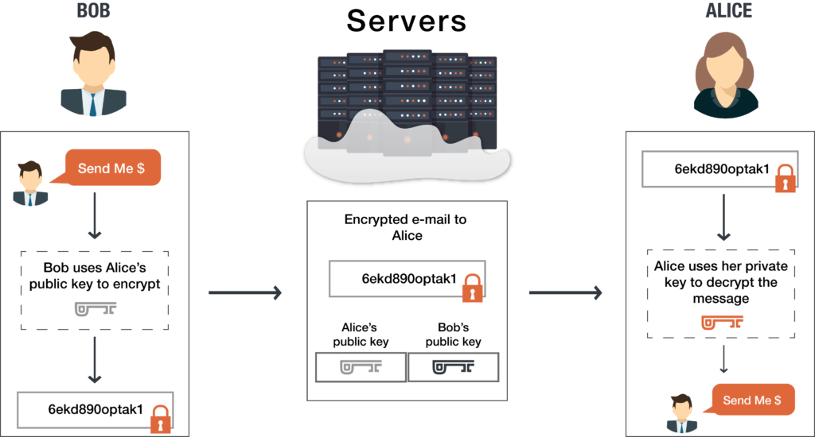

Public Key Infrastructure (PKI)
Bob wants to send Alice an encrypted email. To do this, Bob takes Alice’s public key and encrypts his message to her. Then, when Alice receives the message, she takes the private key that is known only to her in order to decrypt the message from Bob.

Slide 4

Public Key Infrastructure (PKI)
How do I find my public key certificate?
Public key is embedded in the SSL certificate and Private key is stored on the server and kept secret. When a site visitor fills out a form with personal information and submits it to the server, the information gets encrypted with the public key to protect it.
But before we know about where we can find the public key let’s talk about (ssl) and (tls) certificate.

Slide 5

SSL and TLS
Cryptographic Protocols
An SSL certificate (Secure Sockets Layer certificate) is a digital certificate that primarily serves two key purposes in the context of web security:
Encryption: SSL certificates are used to encrypt data transmitted between a user's web browser and a web server.
Authentication: SSL certificates are used to authenticate the identity of a website or web server.

Slide 6

SSL Certificate
The SSL certificate contains a public key as one of its components. Here's how it works:
Public Key: The SSL certificate includes a public key, which is part of a key pair.
Private Key: The private key, on the other hand, is closely guarded by the website owner and is never shared with anyone.
The SSL/TLS handshake process involves the exchange of cryptographic keys between the client (user's browser) and the server (web server).
Transport Layer Security(TLS)

Slide 7
Overview
Three Levels of SSL Certificates:
Domain Validated (DV)
Basic verification.
Organization Validated (OV)
Moderate verification.
Extended Validated (EV)
Rigorous verification.

Slide 8
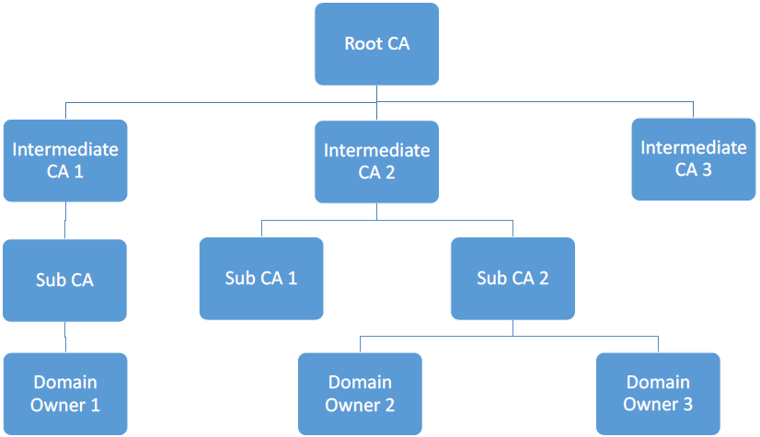
There are many CAs in the real world, and they are organized in a hierarchical structure

Slide 9
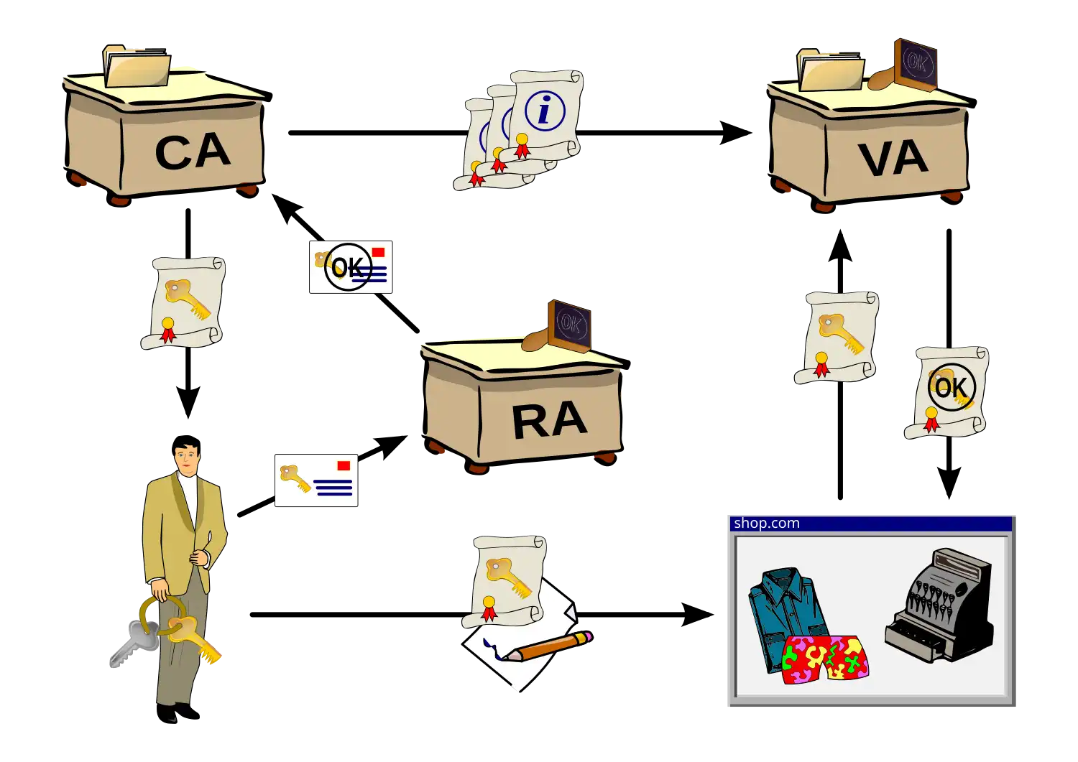
PKI

Slide 10
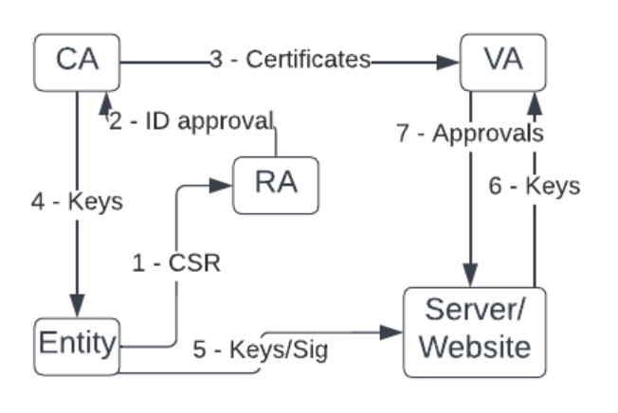
PKI

Slide 11
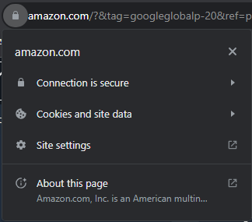
Public Key Infrastructure (PKI)
Now let’s go back and know how to find the public key from any website!!!
Go to any website you want (for ex: I will open the amazon)
Now on the search bar on google chrome you will see a lock
When you click on the lock a pop window will appear
Click on [Connection is secure]

Slide 12
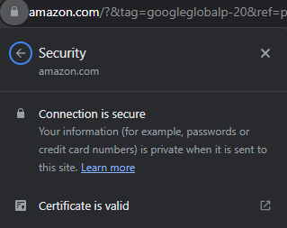
Public Key Infrastructure (PKI)
Now click on [Certificate is valid]

Slide 13
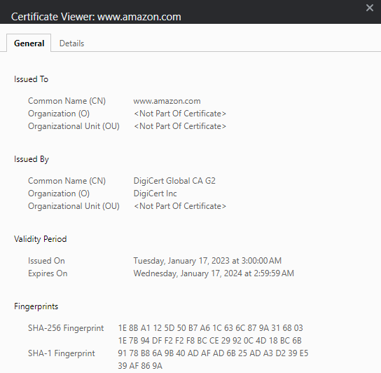
Public Key Infrastructure (PKI)
Now another pop will appear
Press on [Details]

Slide 14
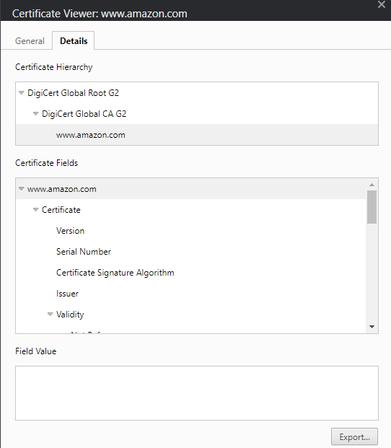
Public Key Infrastructure (PKI)
Now on Certificate Fields search for the public key

Slide 15
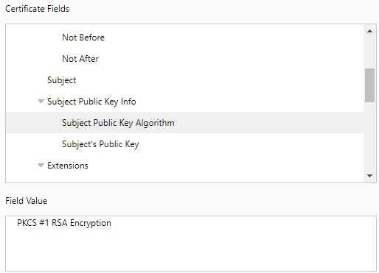
Public Key Infrastructure (PKI)
Now we can see that the amazon website is used RSA Encryption Algorithm

Slide 16
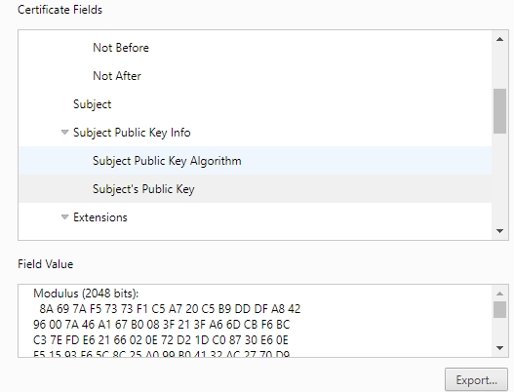
Public Key Infrastructure (PKI)
Now we get the public key for amazon website and it’s a 2048 bits

Slide 17
Installing OpenSSL
sudo apt-get install openssl
openssl help
openssl enc –help
openssl list-cipher-algorithms
openssl enc -ciphers

Slide 18
How to use ssl for enecrypt files
cd Desktop
nano “Hello Cyber Kingdom!!!” > test.txt
openssl aes-256-cbc -a(to encode the encrypted message using a different encoding method of Base64 before storing the results in a file) -in test.txt -out test.enc
enter aes-256-cbc encryption password:123456
Verifying - enter aes-256-cbc encryption password:123456
cat test.txt

Slide 19
How to use ssl for decrypt files
openssl aes-256-cbc -a -d(for decoding) -in test.enc -out decrypted_test.txt
enter aes-256-cbc encryption password: ???
Verifying - enter aes-256-cbc encryption password: ???
cat decrypted_test.txt

Slide 20
SSH
An SSH (Secure Shell) public key is a component of SSH key-based authentication, a method used to securely access remote servers and systems over a network.
When you attempt to connect to a remote server via SSH, the server asks you to prove your identity. Instead of using a password, you can use your SSH key pair. Here's how it works:
You provide your public key to the server or system administrator.
When you attempt to log in, the server sends you a challenge.
Your SSH client uses your private key to sign the challenge.
The server verifies the signature using your public key. If the signature matches, you're granted access without needing to enter a password.

Slide 21
SSH
ssh
sudo apt-get install openssh-server
sudo apt-get install openssh-client
sudo service ssh start
ssh (device name)@(ip)
now enter the device or server password
logout(to end the ssh)

Slide 22

But the real question is how to get the private key? Any ideas!!!

